Slide 1
Salary gap and Parental Leave in the EU
Blanca Altés <blancaaltes@gmail.com>
Breno Milagre <breno_milagre@hotmail.com>
Eugenia Langen <langen.eugenia@gmail.com>
Francesco Caberlin <f.caberlin@gmail.com>
Georgia Martha Sari <gmartha.sari@gmail.com>
Neelima Divi <neelima.divi@gmail.com>
Valentina Atanassova <at.valentina@gmail.com>

Slide 2

Project target
Question to be answer and hypothesis
Is there a correlation between salary gap and parental leave?
Does the salary gap decrease when given equal maternity and paternity leave rights?
Does the ratio between female and male salaries improve with the duration of maternity leave?
Process of analysis
Data Used
Clean data
Search available data
Salary gap as defined by OECD (% of male median wage)
Mean monthly salary as identified by ILO, and calculate ratio female/male salaries
Equivalent paid leaves as defined by OECD
Preliminary images
Regresion results

Slide 3
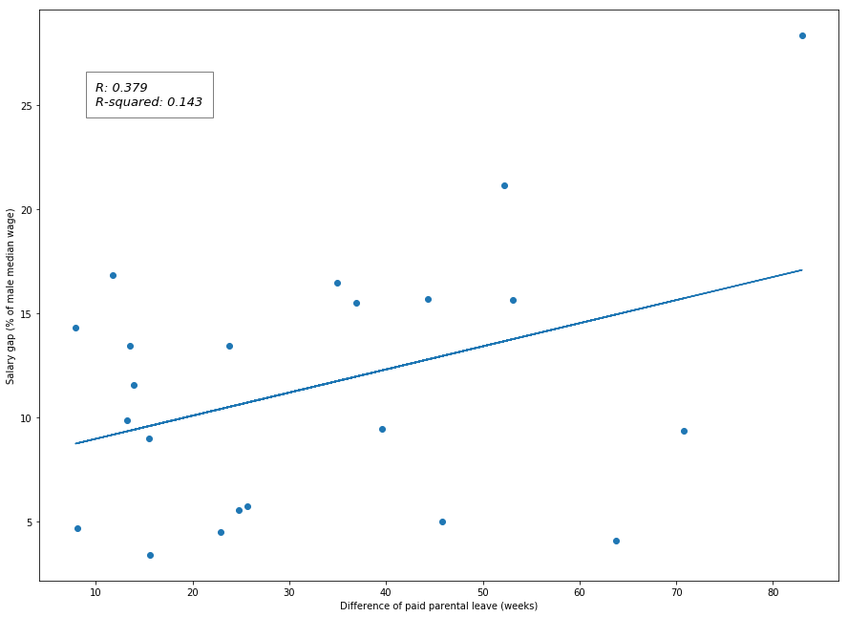
Salary gap vs difference of paid parental leave
Extract of a larger analysis
Dep. Variable: | MedianSalGap | R-squared: | 0.143
Model: | OLS | Adj. R-squared: | 0.100
Method: | Least Squares | F-statistic: | 3.346
Date: | Sat, 21 Jul 2018 | Prob (F-statistic): | 0.0823
Time: | 17:02:45 | Log-Likelihood: | -69.586
No. Observations: | 22 | AIC: | 143.2
Df Residuals: | 20 | BIC: | 145.4
Df Model: | 1
Covariance Type: | nonrobust
 | coef | std err | t | P>|t| | [0.025 | 0.975]
DeltaPaidLeave | 0.1111 | 0.061 | 1.829 | 0.082 | -0.016 | 0.238
Intercept | 7.8491 | 2.366 | 3.318 | 0.003 | 2.914 | 12.784
© 2017 Udacity. All rights reserved.

Slide 4
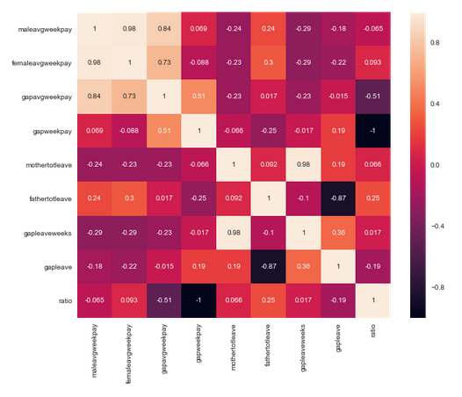
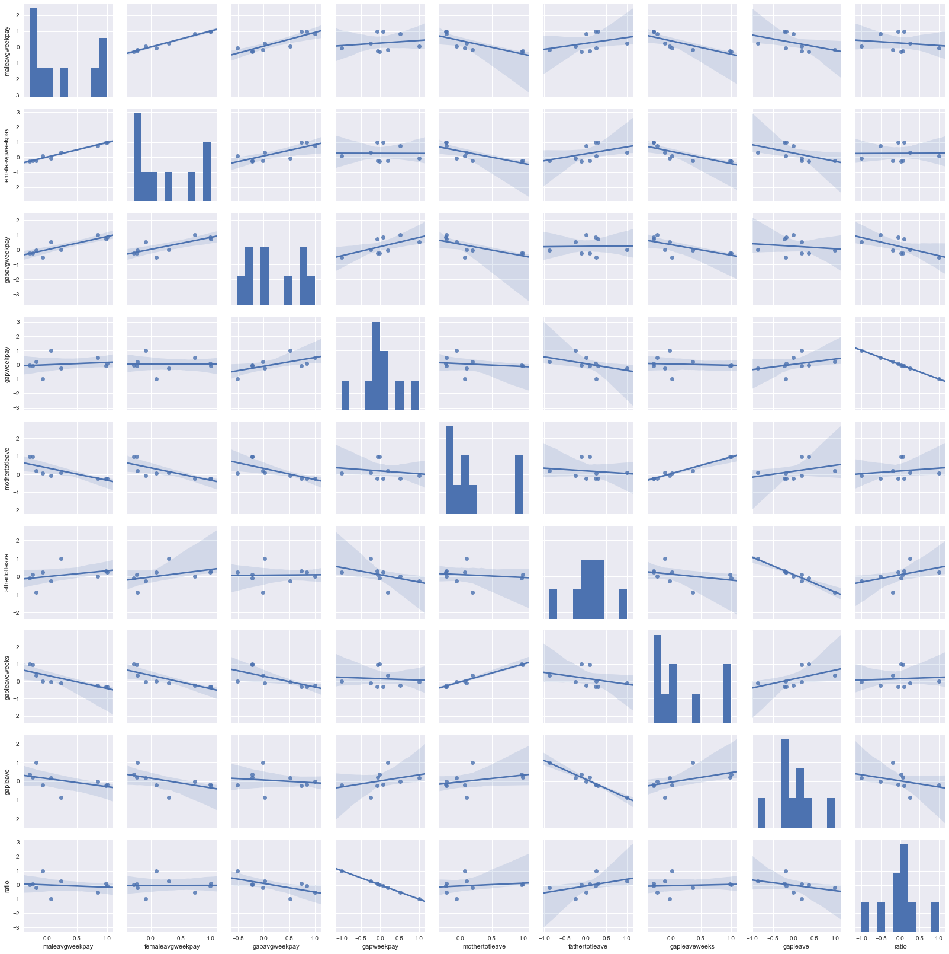
Further correlation analyses
© 2017 Udacity. All rights reserved.

Slide 5
Conclusion
Salary gap and Parental Leave in the EU
From the analysed data, there seems not to be a relevant correlation between paid leaves and differences in salary between female and male employees, despite maternity being often quoted as one of the persistent reasons for the gender gap in salary.
Further analysis is needed before drawing any other conclusions.
Most of the data regarding parental leaves have a ratio between paternal and maternal leaves below 0.15. Hence the conclusions inferred for equal paternal and maternal leaves are not robust.

Slide 6
Key References
Salary gap and Parental Leave in the EU
ILO dataset on mean monthly salary ; 07/15/18 accessed;
OECD dataset on gender wage gap ;07/15/18 accessed;
OECD dataset on paid parental leave ;07/15/18 accessed;
OECD Family Database, Key characteristics of parental leave systems; 07/20/18 accessed; http://www.oecd.org/els/family/database.htm
Jana van Belle, Paternity and Parental leave policies across the European Union; 07/20/18 accessed; https://www.rand.org/content/dam/rand/pubs/research_reports/RR1600/RR1666/RAND_RR1666.pdf
Solomon W. Polachek, Equal pay legislation and the gender wage gap; 07/20/18 accessed; https://wol.iza.org/uploads/articles/16/pdfs/equal-pay-legislation-and-the-gender-wage-gap.pdf
© 2017 Udacity. All rights reserved.

